Slide 1
Q.1
ALL DUPLICATES REMOVED
BLANK COMMENTS ARE FILLED

Slide 2
Q.1

Slide 3
Q.3
Row Labels | Average of views | Sum of comment_count | Sum of likes | ENGAGEMENT
Autos & Vehicles | 333265.3824 | 26945 | 189163 | 216108
Comedy | 717054.7935 | 3117473 | 38804398 | 41921871
Education | 92618.26474 | 455965 | 3529171 | 3985136
Entertainment | 574766.2767 | 8969633 | 83836195 | 92805828
Film & Animation | 1800523.971 | 1196090 | 14308758 | 15504848
Gaming | 3436401.95 | 178580 | 1988458 | 2167038
Howto & Style | 826816.9331 | 411823 | 4322796 | 4734619
Movies | 3862190 | 4617 | 80026 | 84643
Music | 2017880.624 | 3450605 | 54100112 | 57550717
News & Politics | 297358.62 | 1056430 | 5762909 | 6819339
People & Blogs | 450423.3628 | 1032463 | 8841134 | 9873597
Pets & Animals | 2490776 | 21384 | 186307 | 207691
Religious | 56945.04348 | 7014 | 127654 | 134668
Science & Technology | 664622.3467 | 3381982 | 9566636 | 12948618
Shows | 649225.5372 | 64106 | 427347 | 491453
Sports | 1379353.406 | 786327 | 9389714 | 10176041
Travel & Events | 192907.75 | 2236 | 13048 | 15284
ENGAGEMENT RATE IS CALCULATED FOR EACH CATOGORY

Slide 4
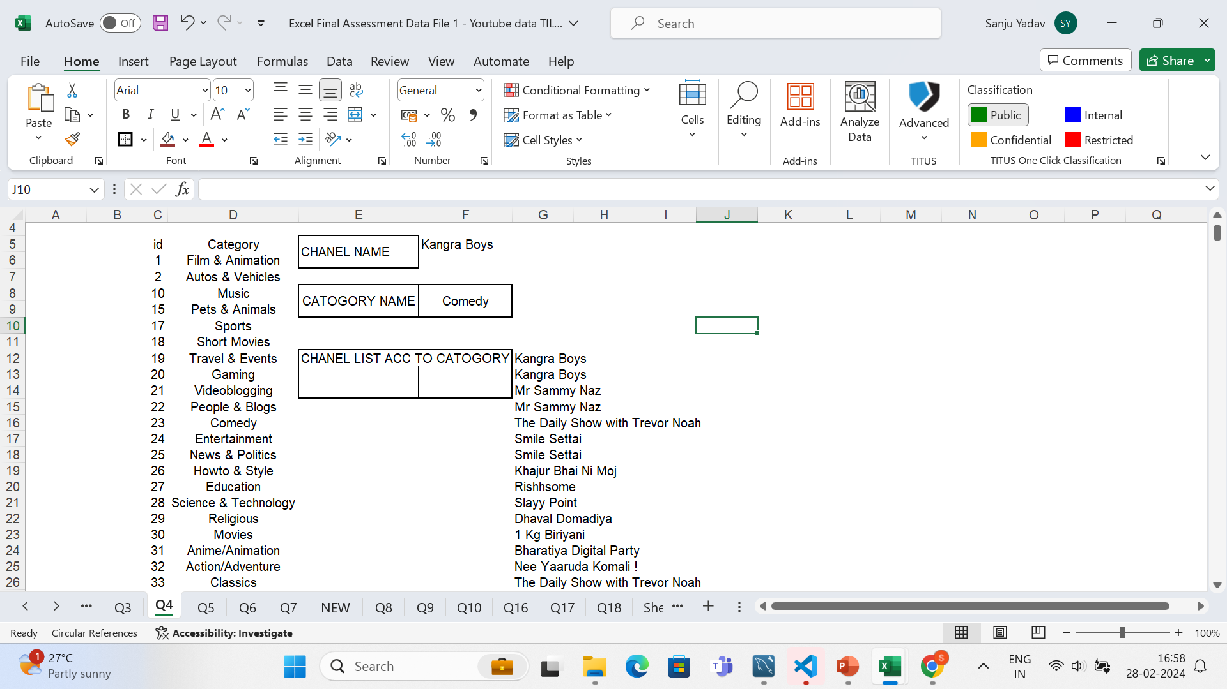
Q.4
I HAVE FILTERED DATA ACCORDING CATOGORY
THEN I USED XLOOKUP
LIST OF ALL CHANNELS OF A SEPCIFIC CATOGORY IS ALSO SHOWEN

Slide 5
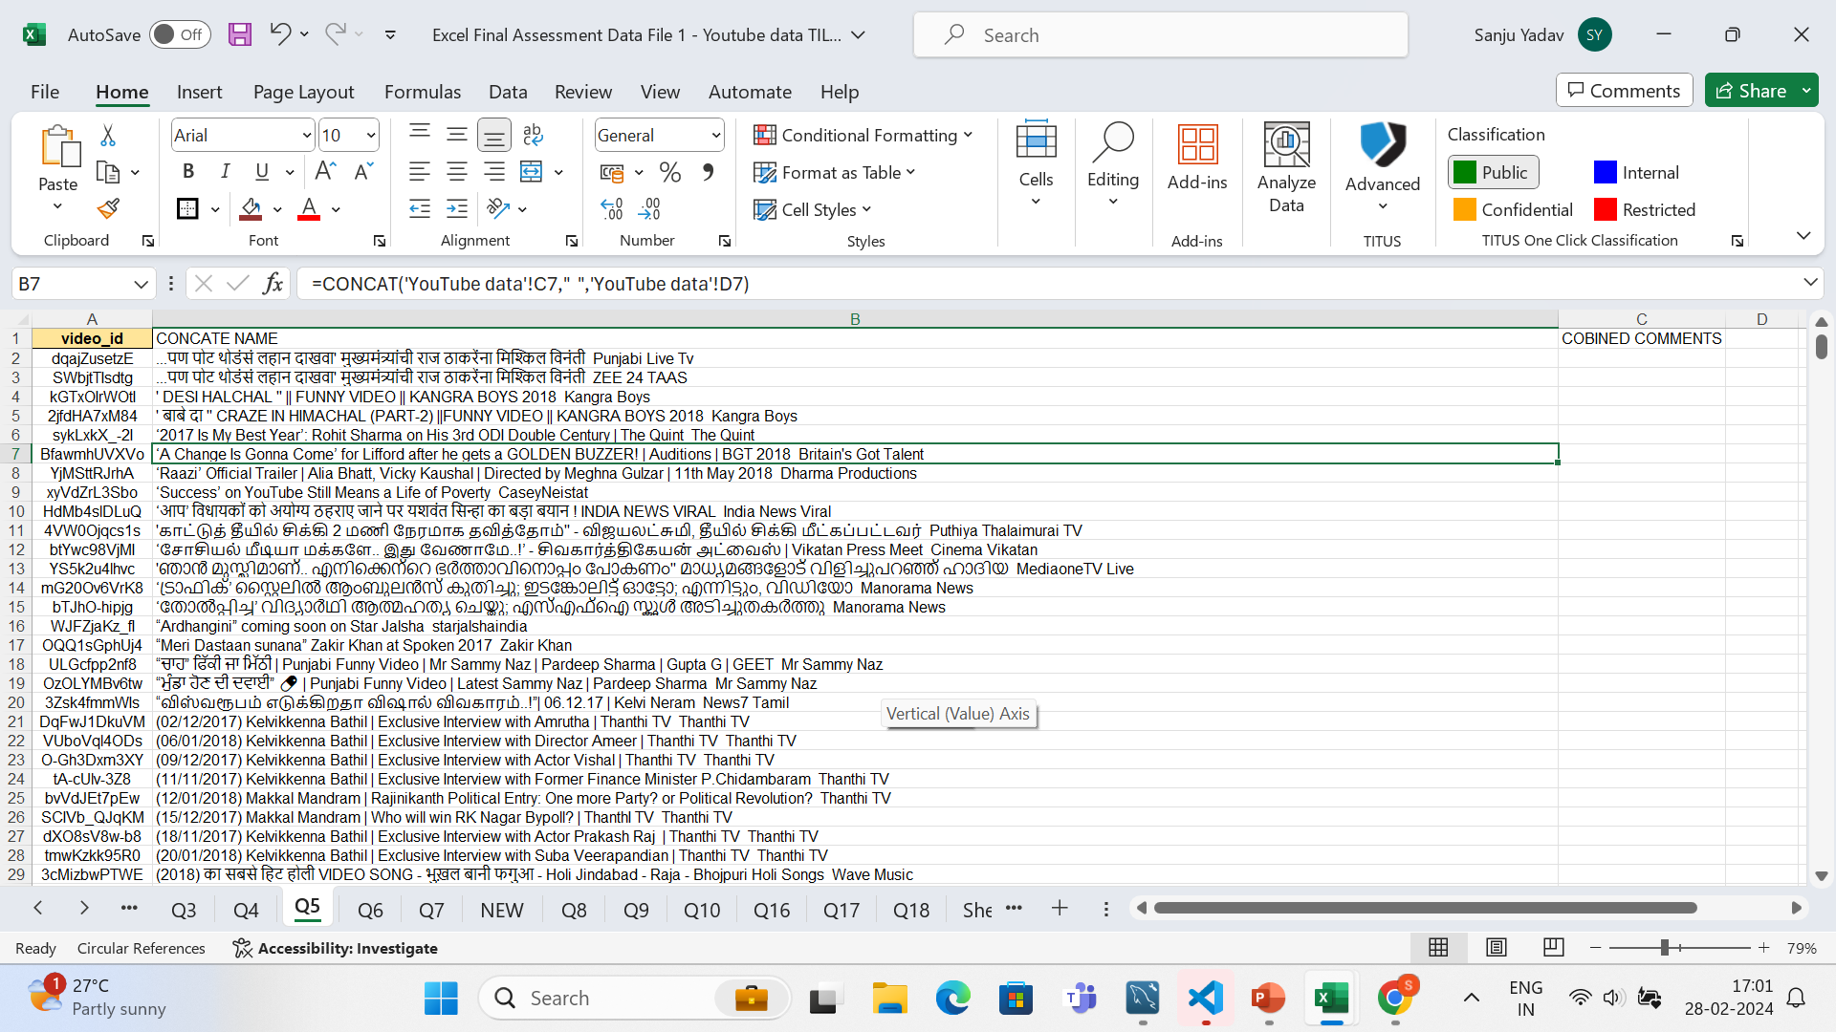
Q5
I USED CONCATINATE TO JOIN TITLE AND CHANEL TITLE

Slide 7
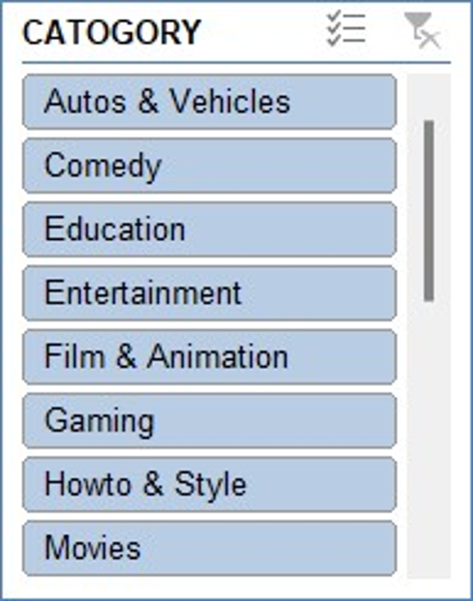

Slide 8
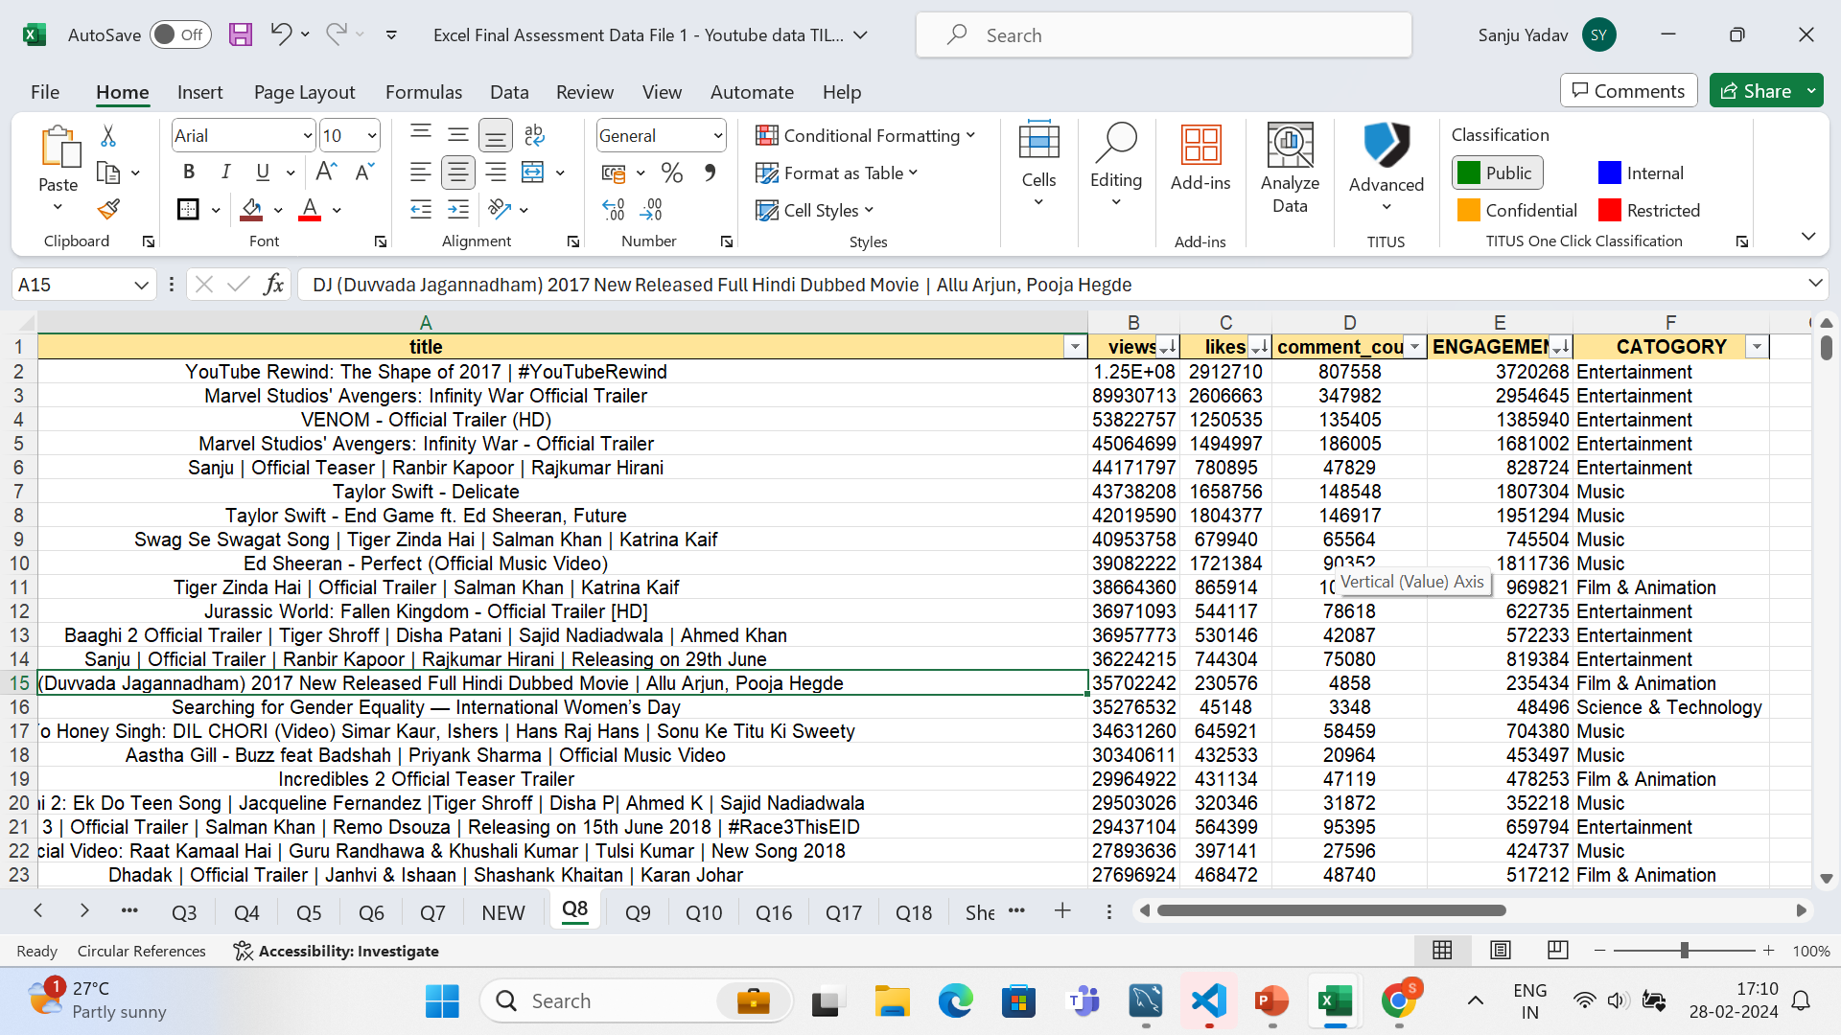
Q8
I HAVE ARRANGED AND FILLTERD ACCORDING EVERY CATOGORY IF I WILL CHOOSE ANY CATOGORY IT WILL SHOW TOP 5 ON TOP FIVE ROWS

Slide 9
Q9
Row Labels | Sum of views
<27-05-2017
<27-05-2017
2017 | 2700407997
May | 58175
Nov | 999488217
Dec | 1700861605
2018 | 8445909227
Jan | 1477413068
Feb | 1540024062
Mar | 1712342604
Apr | 1376758448
May | 1577163430
Jun | 762207615
WE CAN SEE IN DEC 2017 AND MARCH 2018 VIDEO VIEWS ARE HIGHEST
IN JUNE 2018 VIEWS ARE LOWEST

Slide 10
Q10
HERE WE CAN SEE HOW MUCH THEY GAIN AND LOOSE IN NEXT YEAR
BY EVERY CATOGRY WE CAN CHECK

Slide 13
Q13
Row Labels | Sum of comment_count
Autos & Vehicles | 26945
Comedy | 3117473
Education | 455965
Entertainment | 8969633
Film & Animation | 1196090
Gaming | 178580
Howto & Style | 411823
Movies | 4617
Music | 3450605
News & Politics | 1056430
People & Blogs | 1032463
Pets & Animals | 21384
Religious | 7014
Science & Technology | 3381982
Shows | 64106
Sports | 786327
Travel & Events | 2236

Slide 15
Q15
RELATION COFF IS 0.958748
Row Labels | Sum of likes | Sum of views
Autos & Vehicles | 189163 | 11331023
Comedy | 38804398 | 798799040
Education | 3529171 | 73816757
Entertainment | 83836195 | 4337761090
Film & Animation | 14308758 | 941674037
Gaming | 1988458 | 68728039
Howto & Style | 4322796 | 395218494
Movies | 80026 | 7724380
Music | 54100112 | 2447689197
News & Politics | 5762909 | 744883343
People & Blogs | 8841134 | 554921583
Pets & Animals | 186307 | 2490776
Religious | 127654 | 3929208
Science & Technology | 9566636 | 199386704
Shows | 427347 | 78556290
Sports | 9389714 | 478635632
Travel & Events | 13048 | 771631

Slide 16
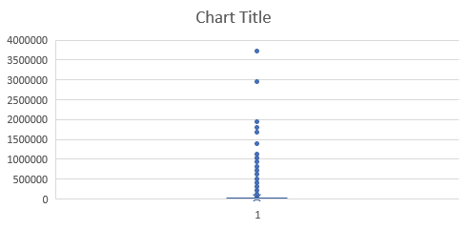
Q16-20 DASHBOARD
QUE 16 TO 20 ARE SOLVED IN DIFFERENT SHEETS AND ALL GRAPHS ARE IN ONLY ONE PPT SLIDE

